Slide 1
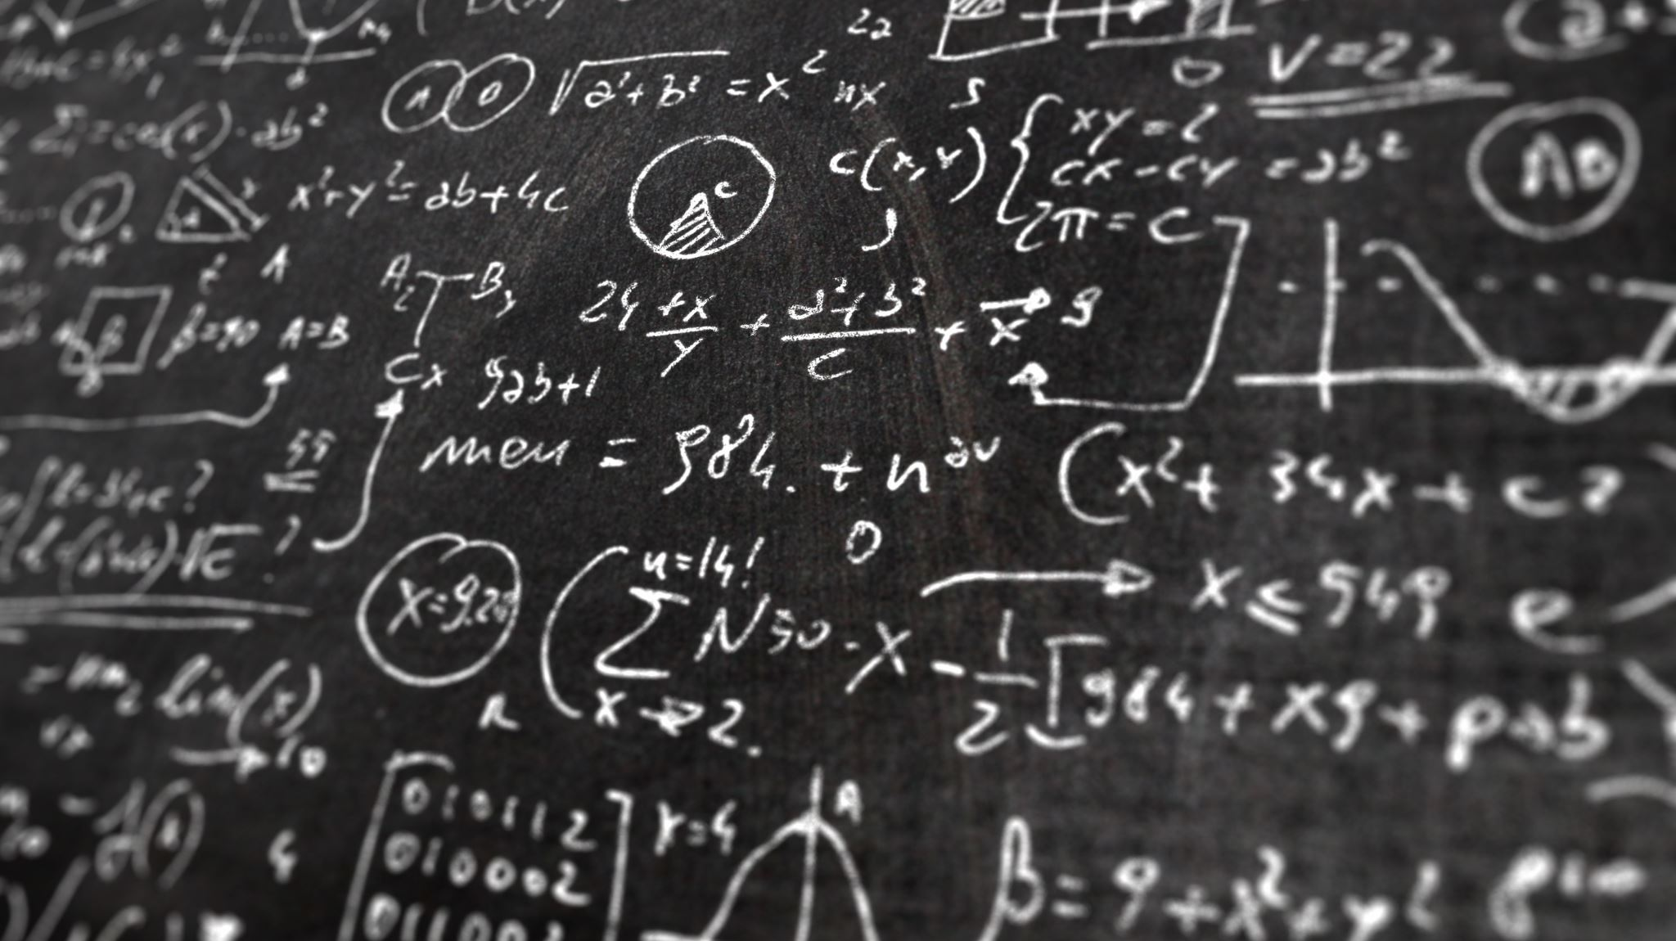
Set theory
Lyernisha S R
Lecturer,FICT

Slide 2
What is a Set?
A set is a collection of elements, or members, or objects. Sometimes, collection is used in place of set to clarify a sentence.
{Alice, Bob, Tom}
{1,2,3,4,5}
Two characteristics of set
–Unordered : {1,2} = {2,1}
–No repeated elements: {1,2} = {1,1,2,2}

Slide 3
Universal Set
The universal set U is the set that contains all objects under consideration.
The letters N, Z, N₀, Q, R, B are reserved in this module to the following special sets :
N = { 1, 2, 3, 4, ...} the set of all natural numbers (in some CS texts, zero is considered to be a natural number).
Z= { ..., –3, –2, –1, 0, 1, 2, 3, ...} the set of all integers
N₀= { 0, 1, 2, 3, 4, ...} the set of all non-negative integers
Q = the set of all rational
R=the set of all real numbers
B= {..., 0, 1, 00, 01, 10, 11, 000, 001, 010, 011, 100, 101, 110, 111, … } the set of all bit strings, including the empty string.

Slide 4
Basic Concepts in Sets
Element
The notation ∈ is used to denote “is an element of “ such as 3∈𝐍 and 2.1∉𝐙
Empty set
The set with no element, denoted by {} or ∅
Subset
The set A is said to be a subset of B if and only if every element of A is also an element of B.
A⊆B is used to indicate that ‘A is a subset of B’.
∅ is a subset of any set, and any set is a subset of itself.
n-subset
Set Ais said to be an n-subset of B if and only if A⊆B and | A| = n.
Superset
The set B is said to be a superset of A if and only if A is a subset of B.

Slide 5
Set Builder Notation
Set builder notation is an alternative way of describing a set, which uses the idea of predicates.
In defining a set A, set-builder notation typically starts with a superset of A, followed by extra conditions on the members of the superset for them to be also members of the set A.
E.g., A= { x∈N | x< 7 }
the set of all x belong to natural numbers such that x is less than 7
This reads as, A is the set of natural numbers such that they are less than seven.
Alternatively, A= { x | x ∈ N ∧ x< 7 }
But, A= { x | x< 7 } is wrong

Slide 6
Equivalence of Sets
Equal sets
𝐴=𝐵⇔𝐴⊆𝐵∧𝐵⊆𝐴
E.g., {1,3,3,5,5,5} = {1,3,5} = {5,1,3}
{1,2,3} ≠{0,1,2}
Proper subset
A is said to be a proper subset (⊂) of B if and only if
𝐴⊆𝐵∧𝐴≠𝐵
E.g., let B={4, {1,2,3}, 5}
4∈𝐵 ,1∉𝐵
{1,2,3}∈𝐵 , {4}⊆𝐵
{{1,2,3}}⊆𝐵

Slide 7
Finite and Infinite Set
S is said to be a finite set that has a finite number of distinct elements.
The number is called the cardinality of S, denoted by |S|.
A set is said to be infinite if it is not finite.
E.g., 𝐴={1,3,3,3,5,5,5,5 } |𝐴|=3
𝐴={Ahmed, Mohamed, Ibrahim, Mariyam} |𝐴|=4
𝐴=∅ |𝐴|= 0
Z is an infinite set. It does not contain a finite number of elements.
𝐴={4,1,2,3,5} |𝐴|= 3

Slide 8
Set Operation -Union
The union of the sets A and B, denoted by 𝐴∪𝐵, is the set that contains all those elements x which satisfy the statement 𝑥∈𝐴∨𝑥∈𝐵. That is, 𝐴∪𝐵={𝑥|𝑥∈𝐴∨𝑥∈𝐵}
E.g., Let 𝐴={2,3,4} and 𝐵=1,3,5, then 𝐴∪𝐵=?

Slide 9
Set Operation -Intersection
The intersection of the sets A and B, denoted by 𝐴∩𝐵, is the set that contains all those elements x which satisfy the statement 𝑥∈𝐴∧𝑥∈𝐵.
That is, 𝐴∩𝐵={𝑥|𝑥∈𝐴∧𝑥∈𝐵}
E.g., Let 𝐴={2,3,4}and 𝐵={1,3,5} then 𝐴∩𝐵=?
A and B are disjoint ⇔𝐴∩𝐵=∅

Slide 10
Set Operation -Difference
The difference of the sets A and B, denoted by 𝐴\𝐵, is the set that contains all those elements x which satisfy the statement 𝑥∈𝐴∧𝑥∉𝐵.
That is, 𝐴\𝐵={𝑥|𝑥∈𝐴 ∧ 𝑥∉𝐵}
E.g., Let 𝐴={2,3,4}and 𝐵={1,3,5} then 𝐴\𝐵=?

Slide 11
Set Operation -Complement
In order to define the complement set, we need to have the concept of the universal set.
Let U be the universal set, and the complement of A, denoted by 𝐴, is the set as 𝐴=𝑈\A={𝑥|𝑥∈𝑈∧𝑥∉𝐴}
Let U=N and 𝐴={2,3,4}, then we have 𝐴={1,5,6,7,…}

Slide 12
Formulae in Set Theory
Similar to propositional logic, we can use letters to represent sets and combine them with four set operators.
E.g., let A={1,2,3,4,5}, B={2,4,6,8,10}, C={2,3,4}
(𝐴∪𝐵)\(𝐵∩𝐶)

Slide 13
Identity in Set Theory
An identity in Set Theory is analogous to logical equivalence in Propositional Logic.
𝐴∪(𝐵∩𝐶)=(𝐴∪𝐵)∩(𝐴∪𝐶)?
–Venn Diagram
–Set builder notation and Propositional logic
–Membership Table

Slide 14
Exercise: Identity of Sets
𝐴\B=𝐴∩(𝐵)?

Slide 15
Power Set
Given a set S, the power set of S is the set of all subsets of the set S, denoted by P(S).
E.g., Let S= {1, 2, 3},
P(S) = {∅,{1},{2},{3},{1,2},{1,3},{2,3},{1,2,3}}
The set-builder notation is
𝑷(𝐴)={𝑋|𝑋⊆𝐴}
Theorem:Let S be a set with cardinality n, then P(S) has cardinality 2^{𝑛}.

Slide 16
Cartesian Product
Let A and Bbe sets. The Cartesian product of A and B, denoted by A×B, is the set of all ordered pairs (a, b) with a ∈ Aand b ∈ B. Or it is defined as
𝐴×𝐵={(𝑎,𝑏)|𝑎∈𝐴∧𝑏∈𝐵}
E.g., let A= {1, 2, 3}, and B= {a, b}, then we have
𝐴×𝐵={{1,𝑎},{2,𝑎},{3,𝑎},{1,𝑏},{2,𝑏},{3,𝑏}}
Cartesian product of more than two sets
The Cartesian product of the sets A₁, A₂,…, A_{n} denoted by A₁ ,A₂ , ….., A_{n}, is given by
𝐴₁×𝐴₂×⋯×𝐴_{𝑛}={(𝑎₁,𝑎₂,…,𝑎_{𝑛})|𝑎₁∈𝐴₁∧𝑎₂∈𝐴₂∧⋯∧𝑎_{𝑛}∈𝐴_{𝑛}}
Theorem: The cardinality of a Cartesian product is the product of the cardinality of the sets within the product. That is:
|𝐴₁×𝐴₂×⋯×𝐴_{𝑛}|=|𝐴₁|×|𝐴₂|×⋯×|𝐴_{𝑛}|

Slide 17
k-fold Product of a Set
The k-fold product of a set A is defined as
𝐴^{𝑘}=𝐴×𝐴×⋯×𝐴(k times)
E.g., 𝐴³=𝐴×𝐴×𝐴
𝐴¹=𝐴
With 𝐴={𝑎,𝑏}
𝐴²=
|𝐴²| =

Slide 18
Counting
Theorem 1: Principle of Inclusion-Exclusion
Let A and B be finite sets, then|𝐴∪𝐵|=|𝐴|+|𝐵|−|𝐴∩𝐵|
Theorem 2: Cardinality of the difference of two sets|𝐴−𝐵|=|𝐴|−|𝐴∪𝐵|

Slide 19
Set exercise
In a group of 60 people, 27 like cold drinks and 42 like hot drinks and each person likes at least one of the two drinks.
How many like both coffee and tea?
Solution: Let A = Set of people who like cold drinks. B = Set of people who like hot drinks. Given
|A ∪ B| = 60 |A| = 27 |B| = 42 then;
|A ∩ B| = |A| + |B| - |A ∪ B| = 27 + 42 - 60 = 69 - 60 = 9 = 9 Therefore, 9 people like both tea and coffee.

Slide 20
Conclusion
•Four set operators
•Cardinality
•Use Venn diagram to prove identity of sets
•Cartesian product

